Slide 1
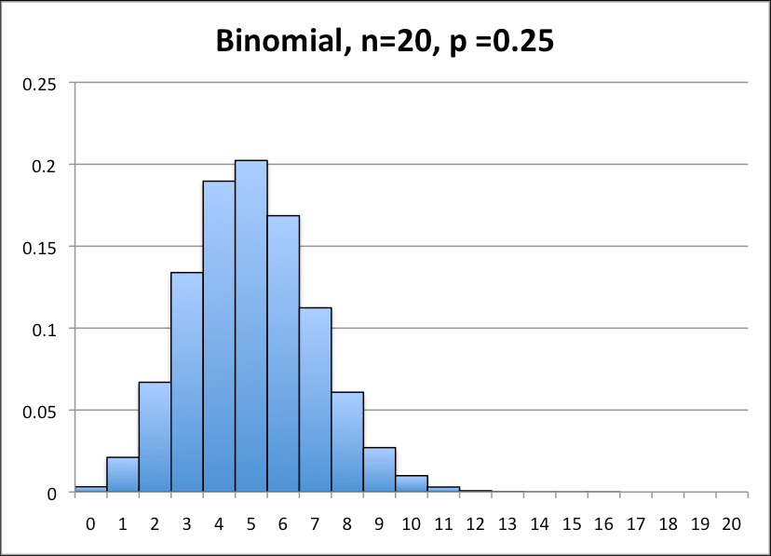
Binomial probability
What is it?
An experiment that occurs n number of trials. Each trial has two possible outcomes, a success or a failure.

Slide 2
Prediction
Predict the likelihood you will make three out of five free throws into a basket?

Slide 3
Refresher
$\left({n \atop r}\right)⋅p^{r}⋅{\left(1−p\right)}^{n−r}$
n= Number of trials
p= Probability of success
r= Number of exact successes

Slide 4
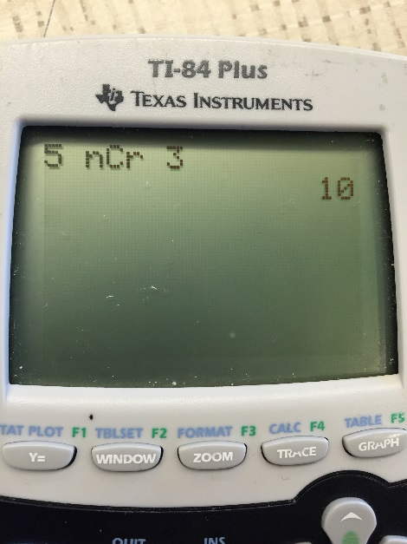
Refresher cont.
_{n}C_{r} = n choose r
Example: five (n) choose three (r) apples
$\left({5 \atop 3}\right)=10$
*to use calculator press MATH -> PRB (left arrow) -> nCr (3)

Slide 5
Example 1
$$\left({n \atop r}\right)⋅p^{r}⋅{\left(1−p\right)}^{n−r}$$
When rolling a die 100 times, what is the probability of rolling a "4"exactly 25 times (rounded to thousandths decimal place)?
n = 100
p = 1/6 = probability of rolling a "4"
r = 25
$\left({100 \atop 25}\right)⋅{\left(\frac{1}{6}\right)}^{25}⋅{\left(1−\left(\frac{1}{6}\right)\right)}^{100−25}$
$= 0.0098258819≈0.010$

Slide 6
Example 2
$$\left({n \atop r}\right)⋅p^{r}⋅{\left(1−p\right)}^{n−r}$$
A test consists of 10 multiple choice questions with five choices for each question. As an experiment, you GUESS on each and every answer without even reading the questions. What is the probability of getting exactly 6 questions correct on this test (rounded to thousandths decimal place)?
$\left({10 \atop 6}\right)⋅{\left(.20\right)}^{6}⋅{\left(1−\left(.20\right)\right)}^{10−6}$
$= 0.005505024≈0.006$
AKA, Don’t try this on the test.

Slide 7
Your turn!
Find out of seven baskets, how many free throws can you make?
Take a crumpled piece of paper and a trash bin to figure this out.

Slide 8
Question
What is the probability that you will make three of the five baskets?

Slide 9
References
http://www.regentsprep.org

