Slide 1
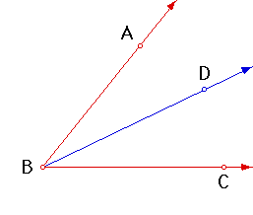
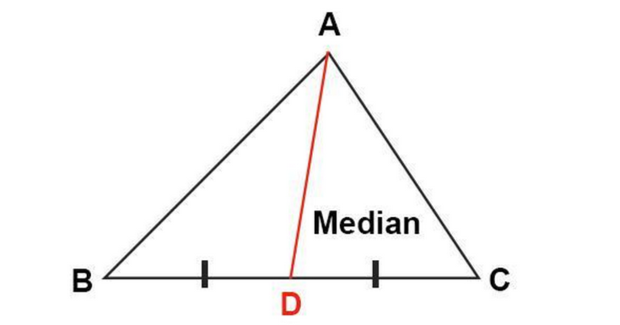
What are Angle Bisectors and Medians?
“Angle bisectors and medians are the same thing!”
True or False

Slide 2
Angle bisectors and medians!
Getting started!
Create two triangles on two different windows (CTRL N).
Graph an incenter on one window and a centroid on another.
Steps for creating a triangle
Plot three points using the polygon tool (Click on the first point plotted to complete the triangle).
Steps for creating an incenter
Using the angle bisector tool (click the triangle in the perpendicular line tool then the angle bisector tool).
Click on points A -> B -> C
Repeat for all angles
Plot a point where all three angle bisectors meet
Steps for creating a centroid
Using the midpoint tool (click the triangle in the point tool then the midpoint tool).
Click on the three triangle sides
Connect the midpoints to the angles opposite to them
Plot a point where all three medians meet

Slide 3
Questions
What is an angle bisector? _____________________
What is a median? _____________________
What is the difference between an angle bisector and a median: _________________________
What is an incenter? ___________________________
What is a centroid?___________________________

Slide 4
Next steps
Create a new window (CTRL N)
Graph an equilateral triangle
Steps for creating an equilateral triangle
Plot three points using the regular polygon tool (click the triangle in the polygon tool then the regular polygon tool).
Plot the centroid
Plot the incenter
What do you notice?
______________________________________

Slide 5
Extra problems
Find the incenter and centroid of a five sided polygon
Find the three perpendicular bisectors and altitudes of a triangle. What do these have in common?

